Slide 1
Hash Tables
Presentation for use with the textbook Data Structures and Algorithms in Java, 6th edition, by M. T. Goodrich, R. Tamassia, and M. H. Goldwasser, Wiley, 2014
0
∅
10.2
1
025-61-0001
2
981-10-0002
3
∅
4
451-22-0004

Slide 2
Hash Tables
Applications of hash tables:
small databases
compilers
browser caches

Slide 3

Recall the Map ADT
get(k): if the map M has an entry with key k, return its associated value; else, return null
put(k, v): insert entry (k, v) into the map M; if key k is not already in M, then return null; else, return old value associated with k
remove(k): if the map M has an entry with key k, remove it from M and return its associated value; else, return null
size(), isEmpty()
entrySet(): return an iterable collection of the entries in M
keySet(): return an iterable collection of the keys in M
values(): return an iterator of the values in M

Slide 4

Intuitive Notion of a Map
Intuitively, a map M supports the abstraction of using keys as indices with a syntax such as M[k].
As a mental warm-up, consider a restricted setting in which a map with n items uses keys that are known to be integers in a range from 0 to N − 1, for some N ≥ n.

Slide 5
More General Kinds of Keys
But what should we do if our keys are not integers in the range from 0 to N – 1?
Use a hash function to map general keys to corresponding indices in a table.
For instance, the last four digits of a Social Security number.
0
∅
1
025-61-0001
2
981-10-0002
3
∅
4
451-22-0004
…

Slide 6
Bucket Array
Even a good hash function may put two or more items in the same “bucket”
Figure 10.4: A bucket array of capacity 11 with entries (1,D), (25,C), (3,F), (14,Z), (6,A), (39,C), and (7,Q), using a simple hash function.

Slide 7
Hash Functions
10.2.1

Slide 8
Hash Functions and Hash Tables 1
A hash function h maps keys of a given type to integers in a fixed interval [0, N − 1]
Example: h(x) = x mod N is a hash function for integer keys
The integer h(x) is called the hash value of key x

Slide 9
Hash Functions and Hash Tables 2
A hash table for a given key type consists of
Hash function h
Array (called table) of size N
When implementing a map with a hash table, the goal is to store item (k, o) at index i = h(k)

Slide 10
Example
We design a hash table for a map storing entries as (SSN, Name), where SSN (social security number) is a nine-digit positive integer
Our hash table uses an array of size N = 10,000 and the hash function h(x) = last four digits of x
0
∅
1
025-61-0001
2
981-10-0002
3
∅
4
451-22-0004
…
9997
∅
9998
200-75-9998
9999
∅

Slide 11
Hash Functions
A hash function is usually specified as the composition of two functions:
Hash code: h₁: keys → integers
Maps a key k to an integer
Compression function: h₂: integers → [0, N − 1]
maps the hash code to an integer within a range of [0, N-1]

Slide 12
Two Parts of Hash Function
p. 411

Slide 13
Hash Codes
10.2.1.x
p. 412

Slide 14
Hash Codes
Memory address:
We reinterpret the memory address of the key object as an integer (default hash code of all Java objects)
Good in general, except for numeric and string keys
Address (key object)
Integer

Slide 15
Hash Codes
If non integer key, it will be converted to integer.
Strings use ASCII value to convert.
key object as bits
Integer

Slide 16
Compression Functions
10.2.1.x
p. 416

Slide 17
Compression functions
Once integer hash code determined for a key, compression function needed to map it into the range [0,N-1]
One that minimizes the number of collisions for a given set:
collision: When hash function maps 2 values to same index.

Slide 18
Compression Function: Division Method
Division:
h₂ (y) = y mod N
The size N of the hash table is usually chosen to be a prime
The reason has to do with number theory and is beyond the scope of this course

Slide 19
Compression Function: MAD
Multiply, Add and Divide (MAD):
h₂ (y) = [(ay + b) mod p]mod N
N is the size of bucket array, p is a prime number larger than N, a and b are random integers from rang [0, N-1], with a > 0
a and b are nonnegative integers such that a mod N ≠ 0
Otherwise, every integer would map to the same value b

Slide 20
Collision-Handling Schemes
10.2.2

Slide 21
Collision Handling 1
Collisions occur when different elements are mapped to the same cell
0
∅
1
025-61-0001
2
∅
3
∅
4
451-22-0004
981-10-0004

Slide 22
Collision Handling 2
Separate Chaining: let each cell in the table point to a linked list of entries that map there
Separate chaining is simple, but requires additional memory outside the table
0
∅
1
025-61-0001
2
∅
3
∅
4
451-22-0004
981-10-0004

Slide 23
Collision Handling with Separate Chaining
10.2.2.x

Slide 24

Separate Chaining
Have each bucket store its own secondary container
Each bucket A(j) holds all entries (k,v) such that $h\left(k\right)=j$

Slide 25
Collision Handling with Linear Probing
10.2.2.x

Slide 26
Linear Probing
Open addressing: the colliding item is placed in a different cell of the table
Linear probing: handles collisions by placing the colliding item in the next (circularly) available table cell
Each table cell inspected is referred to as a “probe”
Colliding items lump together, causing future collisions to cause a longer sequence of probes

Slide 27
Linear Probe Insertion
Figure 10.7: Insertion into a hash table with integer keys using linear probing.
The hash function is h(k) = k mod 11.

Slide 28
Linear Probing
Example:
h(x) = x mod 13
Insert keys 18, 41, 22, 44, 59, 32, 31, 73, in this order
18%13 = 5
41%13 = 2
22%13 = 9
44%13 = 5
…
0
1
2
3
4
5
6
7
8
9
10
11
12
41
18
44
59
32
22
31
73
0
1
2
3
4
5
6
7
8
9
10
11
12

Slide 29
Search with Linear Probing
Consider a hash table A that uses linear probing
get(k)
We start at cell h(k)
We probe consecutive locations until one of the following occurs
An item with key k is found, or
An empty cell is found, or
N cells have been unsuccessfully probed

Slide 30
Updates with Linear Probing
To handle insertions and deletions, we introduce a special object, called DEFUNCT, which replaces deleted elements
remove(k)
We search for an entry with key k
If such an entry (k, o) is found, we replace it with the special item DEFUNCT and we return element o
Else, we return null

Slide 31
Updates with Linear Probing 2
put(k, o)
We throw an exception if the table is full
We start at cell h(k)
We probe consecutive cells until one of the following occurs
A cell i is found that is either empty or stores DEFUNCT, or
N cells have been unsuccessfully probed
We store (k, o) in cell i

Slide 32
Collision Handling with Double Hashing
10.2.2.x
p. 419

Slide 33
Double Hashing 1
Double hashing uses a secondary hash function d(k) and handles collisions by placing an item in the first available cell of the series (i + jd(k)) mod N for j = 0, 1, … , N − 1
The secondary hash function d(k) cannot have zero values
The table size N must be a prime to allow probing of all the cells

Slide 34
Double Hashing
Common choice of compression function for the secondary hash function:
d₂(k) = q − k mod q
where
q < N
q is a prime
The possible values for d₂(k) are 1, 2, … , q

Slide 35
Example of Double Hashing
Consider a hash table storing integer keys that handles collision with double hashing
N = 13
h(k) = k mod 13
d(k) = 7 − k mod 7
Insert keys 18, 41, 22, 44, 59, 32, 31, 73, in this order
0
1
2
3
4
5
6
7
8
9
10
11
12
31
41
18
32
59
73
22
44
0
1
2
3
4
5
6
7
8
9
10
11
12

Slide 36
Load Factors, Rehashing and Efficiency
10.2.3

Slide 37
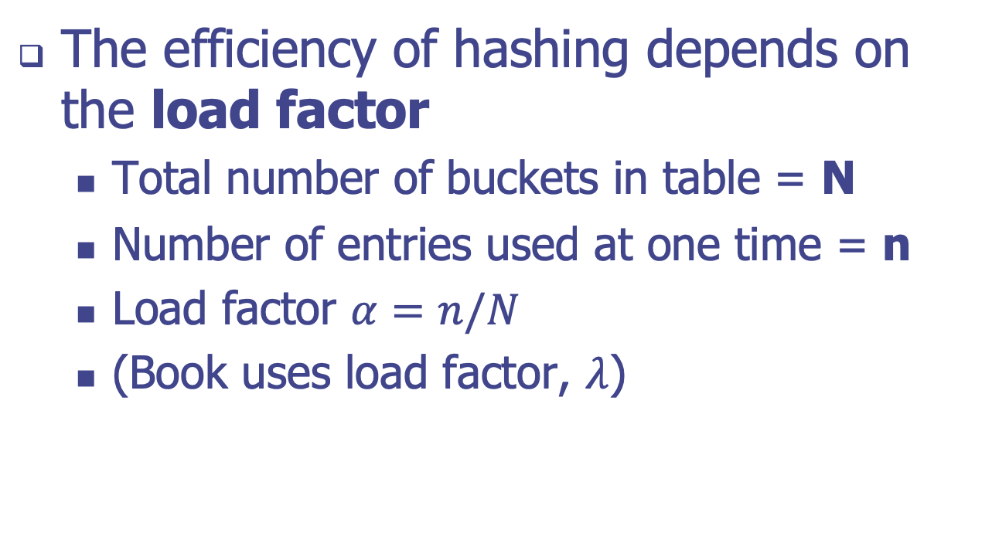
Load Factors
The efficiency of hashing depends on the load factor
Total number of buckets in table = N
Number of entries used at one time = n
Load factor $α=n/N$
(Book uses load factor, $λ$)

Slide 38
Performance of Hashing 1
In the worst case, searches, insertions and removals on a hash table take O(n) time
The worst case occurs when all the keys inserted into the map collide
The load factor α = n(entries)/N(capacity) affects the performance of a hash table
Assuming that the hash values are like random numbers, it can be shown that the expected number of probes for an insertion with open addressing is 1 / (1 − α)

